Slide 1

过关测试卷
模块五 第三章 测试卷

Slide 2
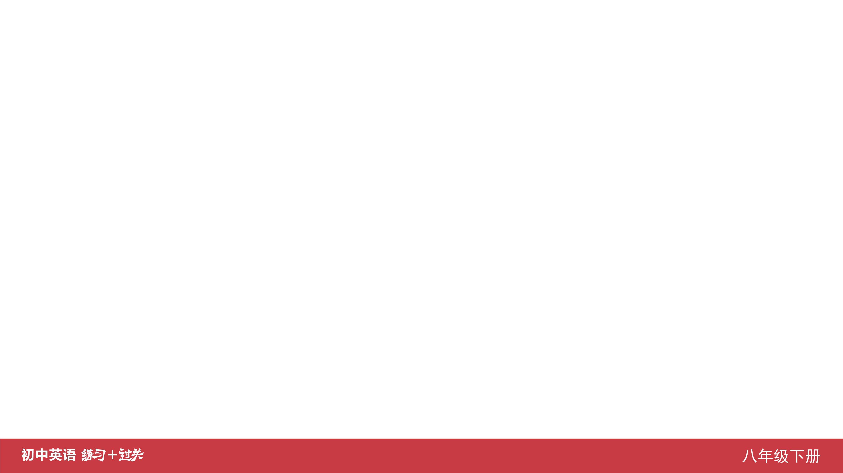
Ⅰ. 听力
1-5 ____________
6-10 ____________
11-15 ____________
16 ____________
17 ____________
18 ____________
19 ____________
20 ____________
AABCB
BACBC
BCCAB
Green
sky
nature
strong
better

Slide 3
Ⅱ. 选择填空
21-25 ____________
26-30 ____________
31-35 ____________
ABCCB
ABCBB
CCACB

Slide 4
Ⅲ. 完形填空
36-40 ____________
41-45 ____________
BCBAB
AABCB

Slide 5
Ⅳ. 阅读理解
46-50 ____________
51-55 ____________
56-60 ____________
61-65 ____________
66-70 ____________
DCCBD
DADBB
BABCD
CBDDC
CBADE

Slide 6
Ⅴ. 情景交际
71. __________________________________
72. __________________________________
__________________________________ 73. __________________________________
__________________________________
How are you feeling these days?
Would you like/love to go to the movies with me this weekend?
Orange makes/can make me feel confident, so I like it.

Slide 7
Ⅴ. 情景交际
74. _______________________________________
75. _______________________________________
_______________________________________
May I speak to Kate, please?
I felt (very) nervous when I gave a/the speech yesterday.

Slide 8
Ⅵ. 看图写话
76. ____________________________________________
____________________________________________
____________________________________________
78. ____________________________________________
____________________________________________
You must/should keep quiet (when you are) in the reading room./
Please keep silent in the reading room.
The mother is looking after her sick child/daughter./
The child is sick and her mother is looking after her.

Slide 9
Ⅴ. 情景交际
78. __________________________________
79. __________________________________
__________________________________ 80. __________________________________
__________________________________
When it rains, the girl/she feels sad.
The boy is proud of his new bike./
He was proud of the new bike.
The old man/He has difficulty carrying/
moving/lifting the heavy box.

Slide 10
Ⅶ. 短文填空
like
trouble
almost
When
surprised
81 ____________
82 ____________
83 ____________
84 ____________
85 ____________
86 ____________
87 ____________
88 ____________
89 ____________
90 ____________
believing
themselves
activities
a
important

Slide 11
Ⅷ. 书面表达
Dear Sandy,
I’m sorry to hear that you feel nervous about the coming final exam. Here is some advice.
First,
I hope my advice can help you. Good luck!
Yours,
Tony
to be well prepared, you should make a review plan and finish it on time. Second, you should go to bed early to get enough sleep so that you can feel good the next morning. Third, you must have a good breakfast because it can give you enough energy. Fourth, keep calm when you’re having the exam. Finally, it’s important for you to be in a good mood. If you are in good spirits, you will do better in the exam. And if you still feel nervous, remember to smile. Smiling will make you relaxed.

Slide 12


